Slide 1
EECE541 Report Presentation
Colour Correction for iTMOs
An, Siqi | Chan, Benny | Liu, Liming | Wang, Zhen
2017-12-15

Slide 2
In this presentation
Introduction-existing work
iTMO overview Process & DeltaE
Colour correction method
Colour region determination
Visualization of alpha map & comparison
Our improvements
Conclusion
Q&A(10 mins)

Slide 3
Agenda
Existing Work – iTMO Process Overview & DeltaE
Colour Correction method
Colour region determination
Visualization of alpha map & comparison
Our improvements
Conclusion
Q&A(10 mins)

Slide 4
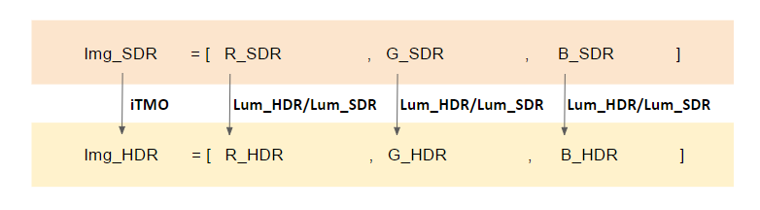
Existing Work
Four iTMO methods —Akyuz, Banterle, Bist & Meylan
Notes:
The contradiction between the present display and human demand contributes to the generation of HDR images.

Slide 5
iTMO Process & DeltaE

Slide 6
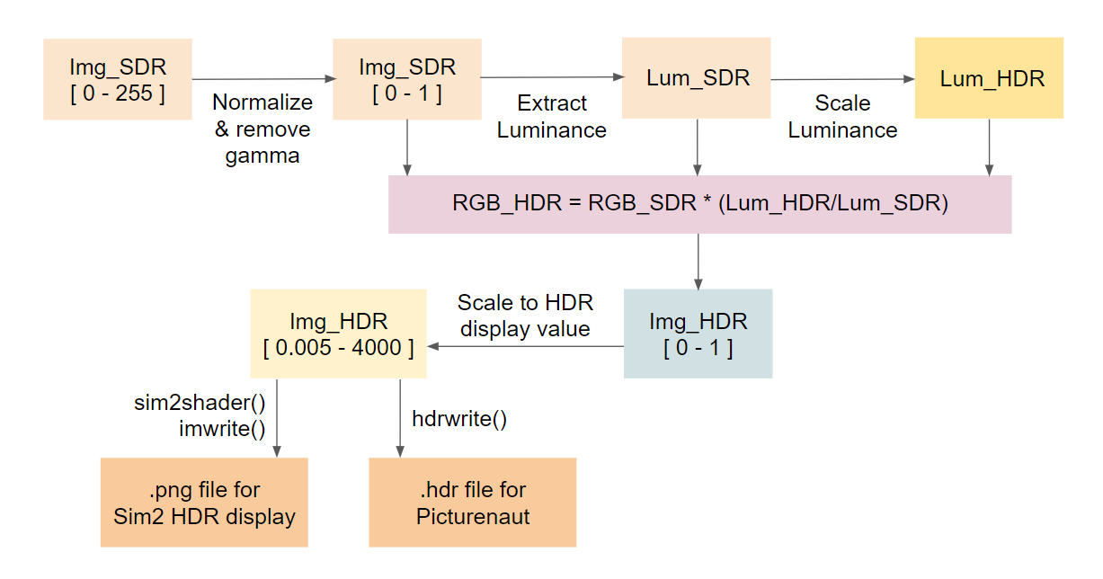
iTMO Process
Process chart with iTMO producing HDR image.

Slide 7
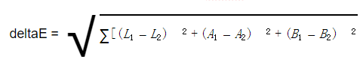
DeltaE
We find out that…
For valid comparison, the immediate result of the iTMO or colour correction in form of matrices needs be used for the deltaE calculation. When the resulting matrix that represents the image is saved as .hdr and loaded as a matrix, error is introduced to the calculation.

Slide 8
Colour Correction for iTMO

Slide 9
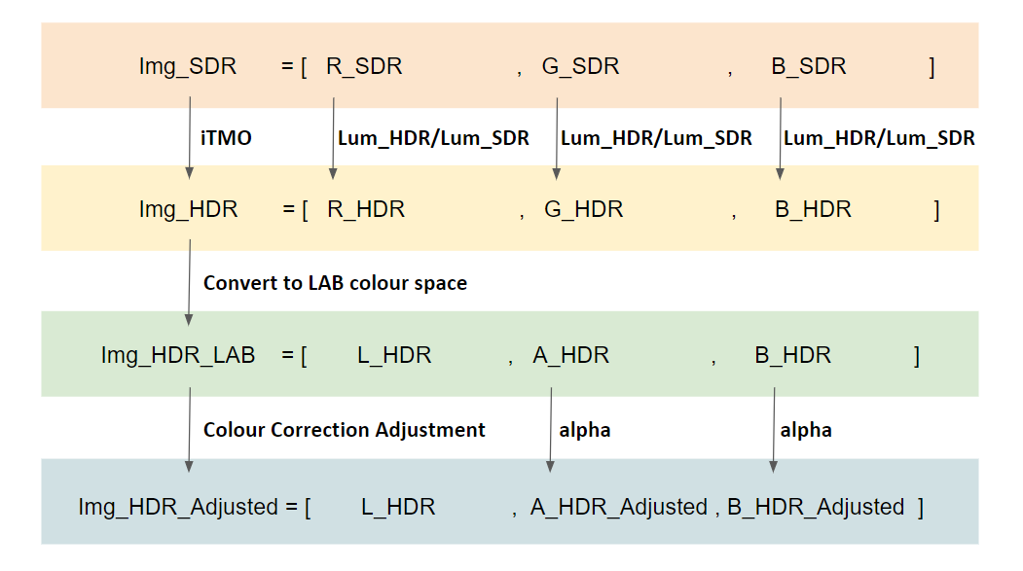
Color Correction Adjustment
Notes:
iTMO is realized through Expansion Operators (EO), and the general global tone expansion models are based on the luminance part of an image. Since we can’t extract the luminance component directly from the RGB color space, we need to convert the RGB image into another color space to do the tone expansion process.In our project, we will convert the RGB color space into XYZ YCbCr LMS ICtCp 4 different color spaces to see the results. Each conversion has its own method settled by CIE and is presented as follows.

Slide 10

Global Method – Finding alpha
Apply one global alpha value on all pixels
Only the A & B value
The value applied to A & B has to be the same
Application on 4 iTMO method
How to find the global alpha value
Notes:
iTMO is realized through Expansion Operators (EO), and the general global tone expansion models are based on the luminance part of an image. Since we can’t extract the luminance component directly from the RGB color space, we need to convert the RGB image into another color space to do the tone expansion process.In our project, we will convert the RGB color space into XYZ YCbCr LMS ICtCp 4 different color spaces to see the results. Each conversion has its own method settled by CIE and is presented as follows.

Slide 11
Color Correction Adjustment
Notes:
iTMO is realized through Expansion Operators (EO), and the general global tone expansion models are based on the luminance part of an image. Since we can’t extract the luminance component directly from the RGB color space, we need to convert the RGB image into another color space to do the tone expansion process.In our project, we will convert the RGB color space into XYZ YCbCr LMS ICtCp 4 different color spaces to see the results. Each conversion has its own method settled by CIE and is presented as follows.

Slide 12
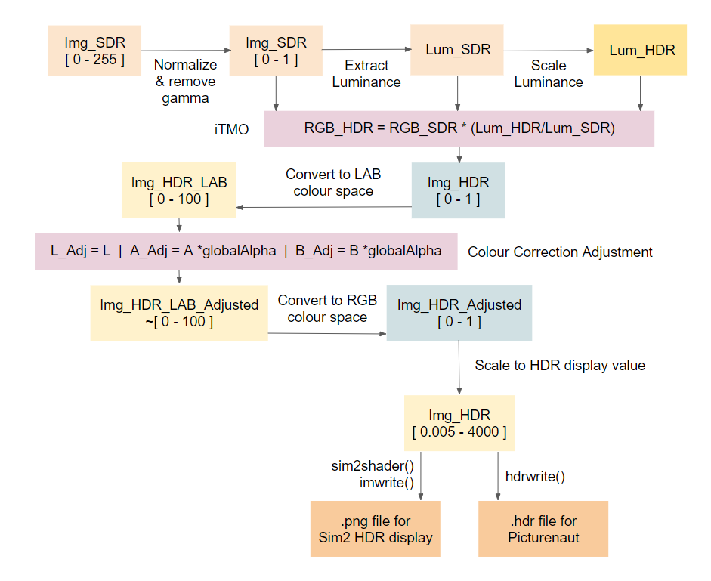
Notes:
iTMO is realized through Expansion Operators (EO), and the general global tone expansion models are based on the luminance part of an image. Since we can’t extract the luminance component directly from the RGB color space, we need to convert the RGB image into another color space to do the tone expansion process.In our project, we will convert the RGB color space into XYZ YCbCr LMS ICtCp 4 different color spaces to see the results. Each conversion has its own method settled by CIE and is presented as follows.

Slide 13
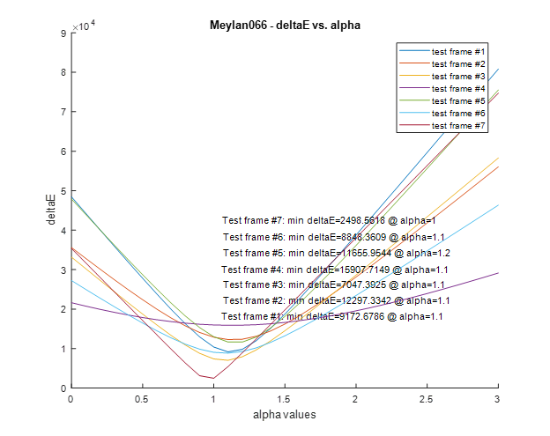
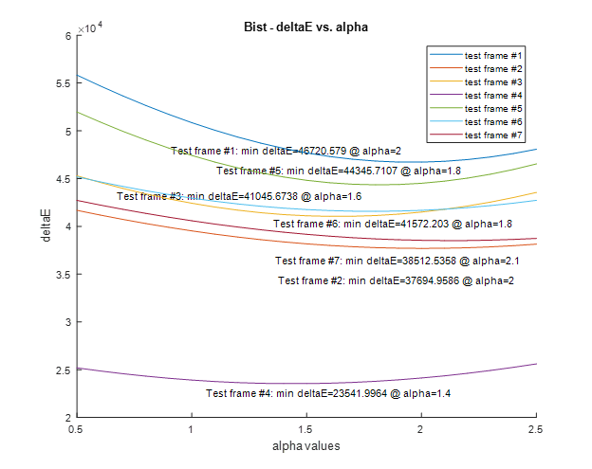
Global Method – Finding alpha
Notes:
iTMO is realized through Expansion Operators (EO), and the general global tone expansion models are based on the luminance part of an image. Since we can’t extract the luminance component directly from the RGB color space, we need to convert the RGB image into another color space to do the tone expansion process.In our project, we will convert the RGB color space into XYZ YCbCr LMS ICtCp 4 different color spaces to see the results. Each conversion has its own method settled by CIE and is presented as follows.

Slide 14
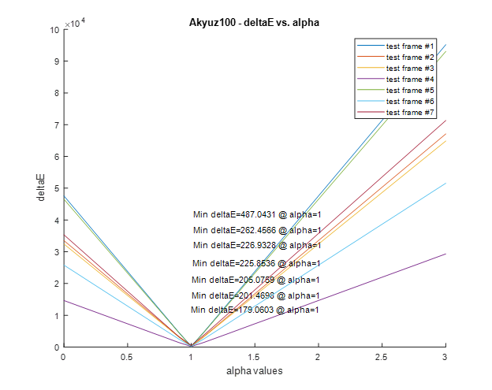
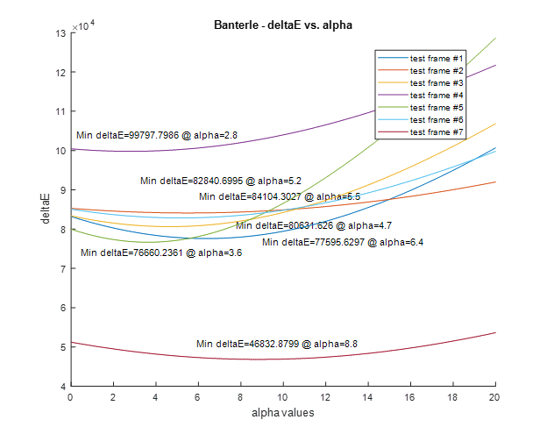
Global Method – Finding alpha
Notes:
iTMO is realized through Expansion Operators (EO), and the general global tone expansion models are based on the luminance part of an image. Since we can’t extract the luminance component directly from the RGB color space, we need to convert the RGB image into another color space to do the tone expansion process.In our project, we will convert the RGB color space into XYZ YCbCr LMS ICtCp 4 different color spaces to see the results. Each conversion has its own method settled by CIE and is presented as follows.

Slide 15
Color Correction Adjustment - Global Method
 | Akyuz gamma = 1.0 |  |  | Banterle |  |  | Bist |  |  | Meylan p=0.66
Test Frames | Original DeltaE | DeltaE min | Corresponding Alpha Values | Original DeltaE | DeltaE min | Corresponding Alpha Values | Original DeltaE | DeltaE min | Corresponding Alpha Values | Original DeltaE | DeltaE min | Corresponding Alpha Values
1- Chair | 262.46 | 262.46 | 1 | 81609.76 | 77595.63 | 6.4 | 50850.89 | 46720.58 | 2 | 10399.13 | 9172.68 | 1.1
2 - Car | 226.93 | 226.93 | 1 | 84901.21 | 84104.3 | 5.5 | 39525.41 | 37694.96 | 2 | 12898.39 | 12297.33 | 1.1
3 - Lake | 201.47 | 201.47 | 1 | 82336.67 | 80631.63 | 4.7 | 42418.39 | 41045.67 | 1.6 | 7389.72 | 7047.39 | 1.1
4 - Family | 205.08 | 205.08 | 1 | 100059.4 | 99797.8 | 2.8 | 23913.66 | 23542 | 1.4 | 15987.36 | 15907.71 | 1.1
5 - Garden | 179.06 | 179.06 | 1 | 78412.93 | 76660.24 | 3.6 | 47420.33 | 44345.71 | 1.8 | 13014.99 | 11655.95 | 1.2
6 - Home | 225.85 | 225.85 | 1 | 84298.85 | 82840.7 | 5.2 | 42955.8 | 41572.2 | 1.8 | 9067.52 | 8848.36 | 1.1
7 - Restaurant | 487.04 | 487.04 | 1 | 50312.46 | 46832.88 | 8.8 | 40584.93 | 38512.54 | 2.1 | 2498.56 | 2498.56 | 1
Notes:
iTMO is realized through Expansion Operators (EO), and the general global tone expansion models are based on the luminance part of an image. Since we can’t extract the luminance component directly from the RGB color space, we need to convert the RGB image into another color space to do the tone expansion process.In our project, we will convert the RGB color space into XYZ YCbCr LMS ICtCp 4 different color spaces to see the results. Each conversion has its own method settled by CIE and is presented as follows.

Slide 16
Color Correction Adjustment - Local Method
A test range of LAB values is established.
An alpha map matrix that is indexed with LAB values for a particular iTMO is created.
Each of the LAB values is converted into RGB values.
The RGB value is processed by an iTMO to create a resulting HDR RGB value.
The resulting HDR RGB value is adjust with an array of discrete numbers to scale both the chrominance A & B values.
The number that results in the lowest deltaE value is selected to be the local alpha value for that LAB value.
The local alpha value is stored in the alpha map matrix.
Step 3 to 7 are repeated for the entire LAB value test range.
Notes:
iTMO is realized through Expansion Operators (EO), and the general global tone expansion models are based on the luminance part of an image. Since we can’t extract the luminance component directly from the RGB color space, we need to convert the RGB image into another color space to do the tone expansion process.In our project, we will convert the RGB color space into XYZ YCbCr LMS ICtCp 4 different color spaces to see the results. Each conversion has its own method settled by CIE and is presented as follows.

Slide 17
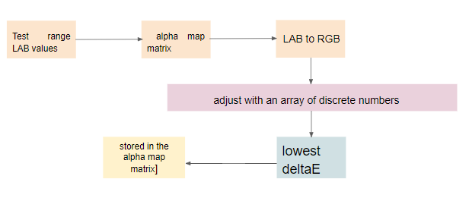
Color Correction with a local alpha value
Process chart
Limitation
Notes:
iTMO is realized through Expansion Operators (EO), and the general global tone expansion models are based on the luminance part of an image. Since we can’t extract the luminance component directly from the RGB color space, we need to convert the RGB image into another color space to do the tone expansion process.In our project, we will convert the RGB color space into XYZ YCbCr LMS ICtCp 4 different color spaces to see the results. Each conversion has its own method settled by CIE and is presented as follows.

Slide 18
Color region Determination

Slide 19
Color region Determination
To find the relationship between different colors and alphas
Color region determination in YCbCr color space:
Hue = Θ = 𝑡𝑎𝑛−1 (Cr\Cb)
The criterion for each color region:
Magenta:22≤ Θ ≤ 80 Red: 80 ≤ Θ ≤ 138
Yellow: 138≤ Θ ≤ 202 Green: 202 ≤ Θ ≤ 259
Cyan: 259 ≤ Θ ≤ 319 Blue: -41 ≤ Θ ≤ 22
Process:
Notes:
When was that

Slide 20
Visualization of Alpha Map & comparison

Slide 21
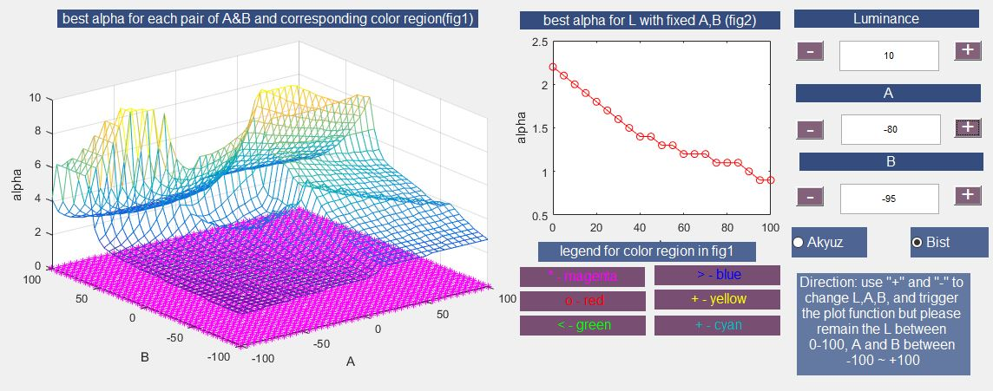
Visualization of Alpha Map
GUI Interface of Alpha Map Visualization Program
Notes:
In order to get a detailed observation into the trend of alpha, we build a program to visualize our alpha map. fig 1, shows the alpha with different A and B in a certain luminance level the x and y axis represent the value of A and B, z axis represent the value of alpha. The marks on the surface of alpha =0 represent the corresponding color region. The fig 2 show the trend of alpha with the increase of luminance for a certain A and B.

Slide 22
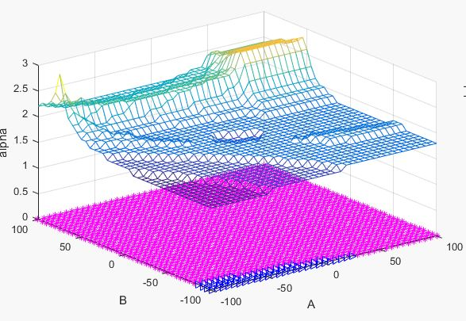
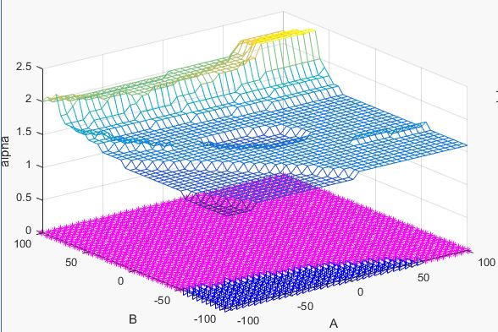
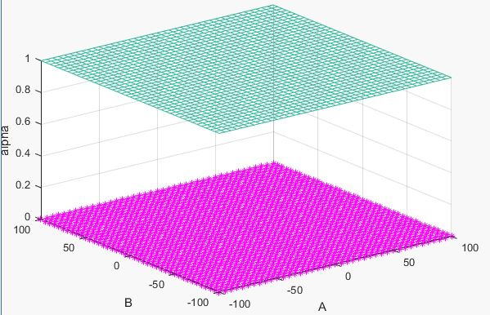
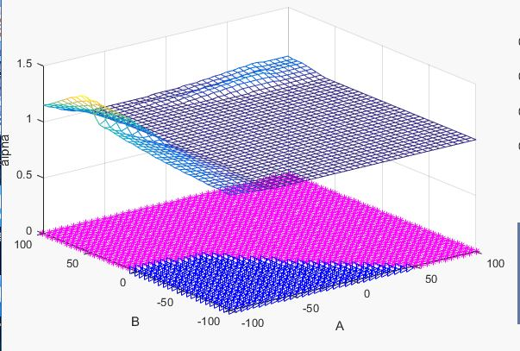
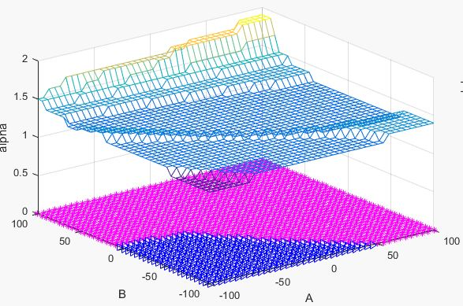
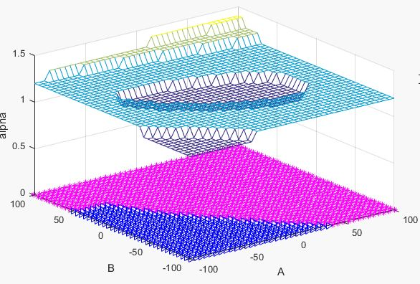
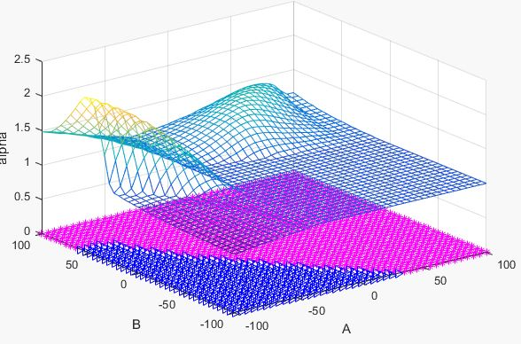
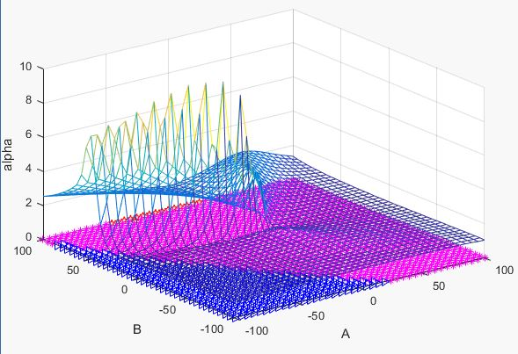
Comparison between Different Alphas
Alpha of each A & B in Bist
Alpha of each A & B in Akyuz
Notes:
Here are some of the output images. From the images we find that for most luminance levels, alpha varies a lot within a same color region, so we cannot determine a fixed alpha for a certain color region. And in bist, we observe a decrease of alpha when luminance increase from 0 to 100, so we suspect a correlation between the local alpha values and the luminance level

Slide 23
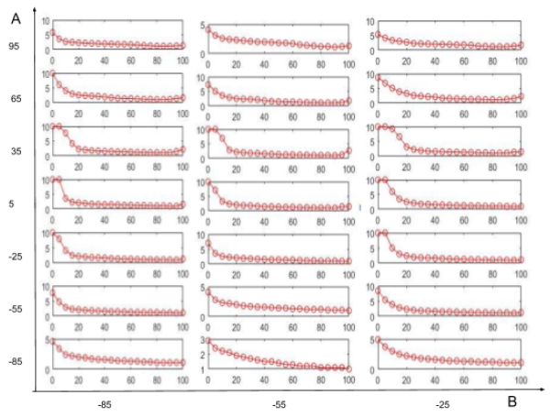
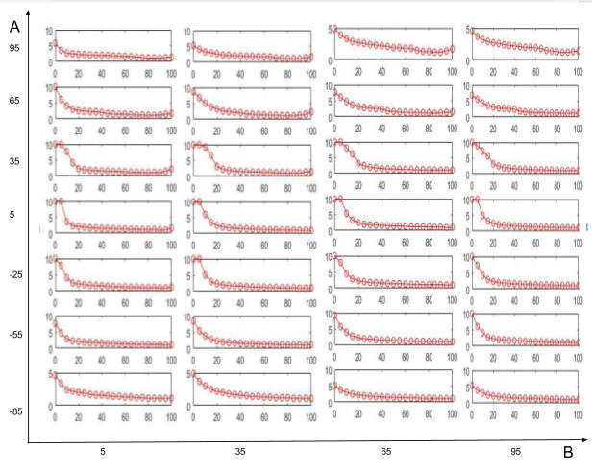
Trend of alpha with the change of luminance
Alpha-Luminance for different fixed A and B in Bist
Alpha-Luminance for B= -85, -55, -25
Alpha-Luminance for B=5, 35, 65, 95

Slide 24
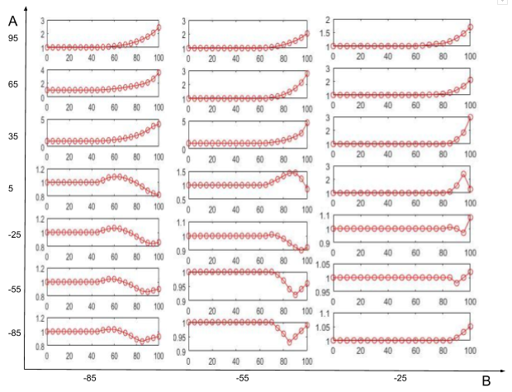
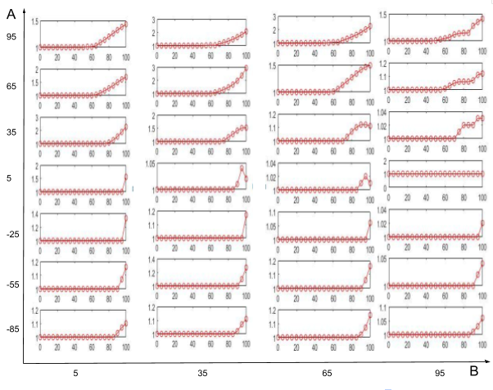
Trend of alpha with the change of luminance
Alpha-Luminance for different fixed A and B in Akyuz
Alpha-Luminance for B= -85, -55, -25
Alpha-Luminance for B=5, 35, 65, 95

Slide 25
Our improvements

Slide 26
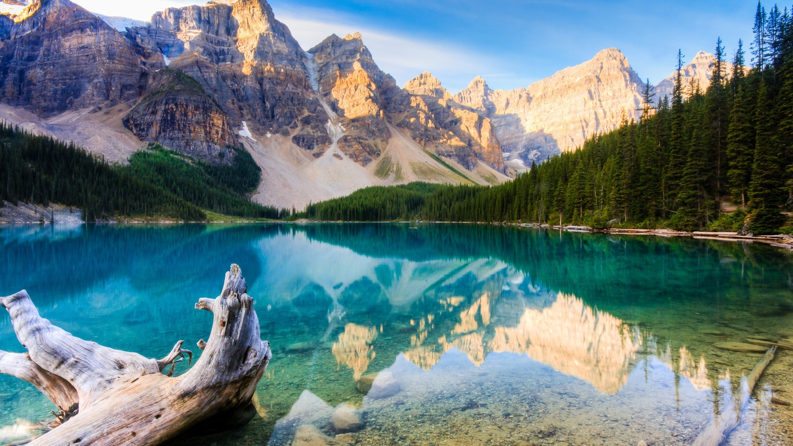
Bist iTMO
3.png named the Lake

Slide 27
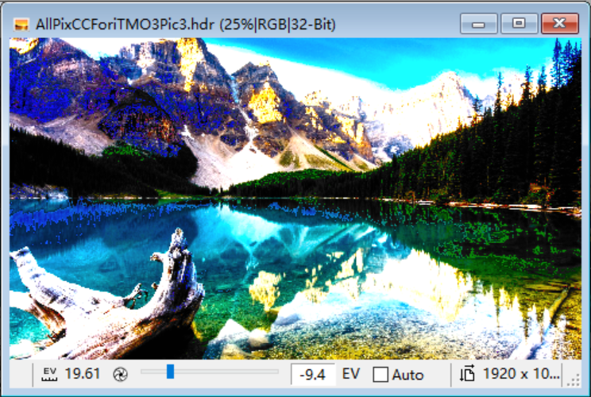
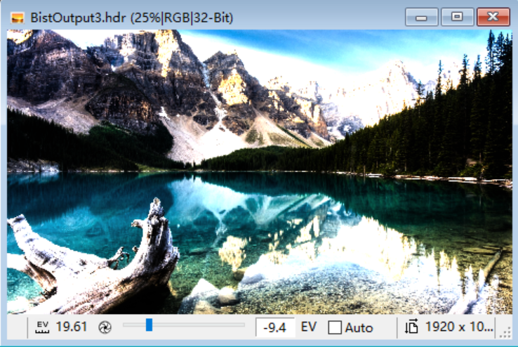
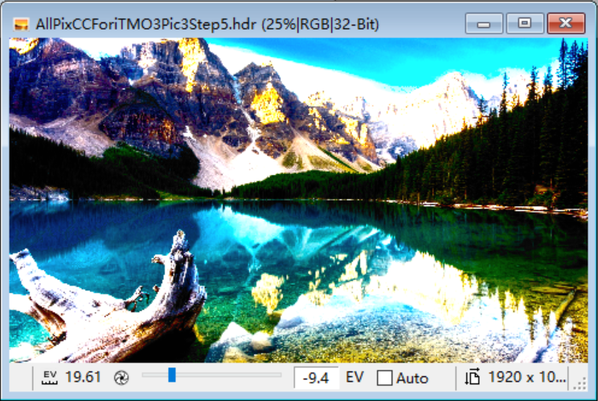
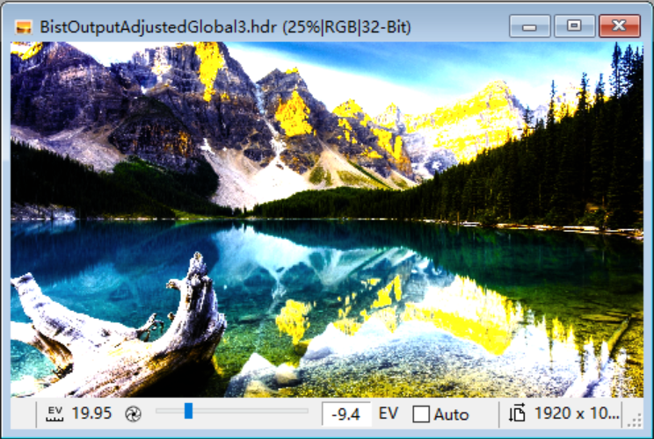
Color correction result
For bist
Colour-corrected HDR images with local alpha map @ step=20
Bist iTMO output HDR image
Color-corrected HDR Image with global alpha of 2.1
Colour-corrected HDR images with local alpha map @ step=5
Notes:
iTMO is realized through Expansion Operators (EO), and the general global tone expansion models are based on the luminance part of an image. Since we can’t extract the luminance component directly from the RGB color space, we need to convert the RGB image into another color space to do the tone expansion process.In our project, we will convert the RGB color space into XYZ YCbCr LMS ICtCp 4 different color spaces to see the results. Each conversion has its own method settled by CIE and is presented as follows.

Slide 28
DeltaE
Test Frames | HDR Direct | Global Alpha | Local Alpha step=20 | Local Alpha step=5
1- Chair | 47247.69 | 46720.58 | 42681.57 | 43453.15
2 - Car | 32117.87 | 37694.96 | 30673.34 | 30764.62
3 - Lake | 39114.81 | 41045.67 | 36060.55 | 36499.56
4 - Family | 32731.43 | 23542.00 | 31650.06 | 31707.26
5 - Garden | 35286.77 | 44345.71 | 32724.77 | 32908.77
6 - Home | 40990.19 | 41572.20 | 39541.89 | 39553.83
7 - Restaurant | 25657.14 | 38512.54 | 23343.16 | 24060.28

Slide 29
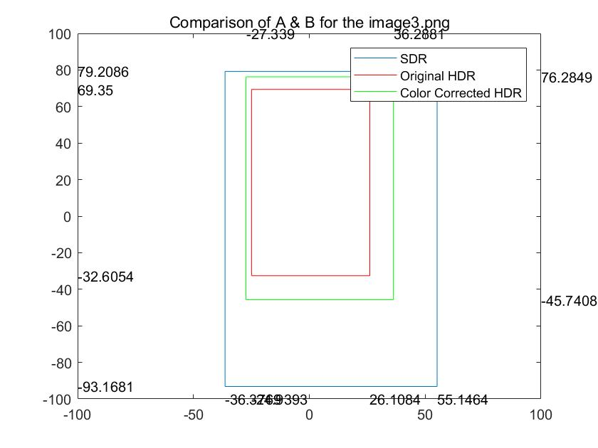
Improvement - range of a and b

Slide 30
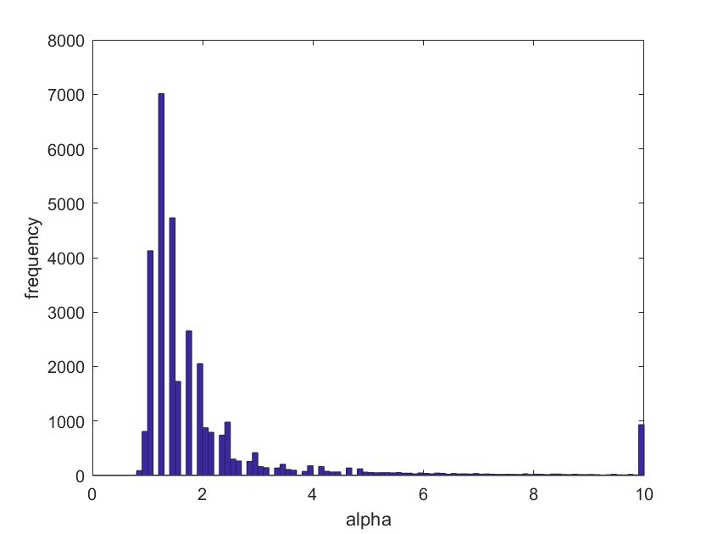
Histogram

Slide 31
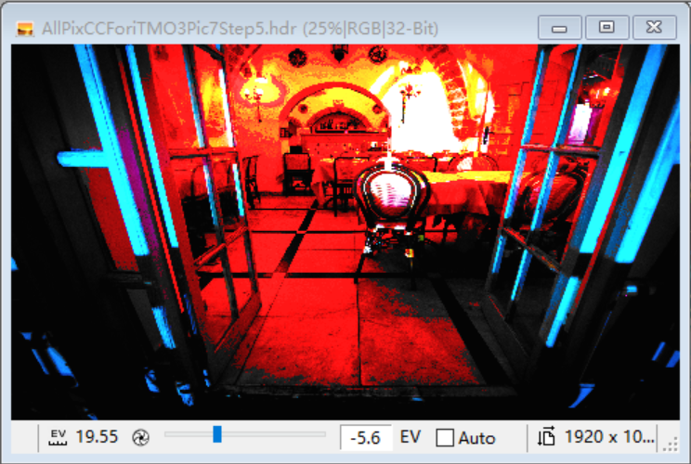
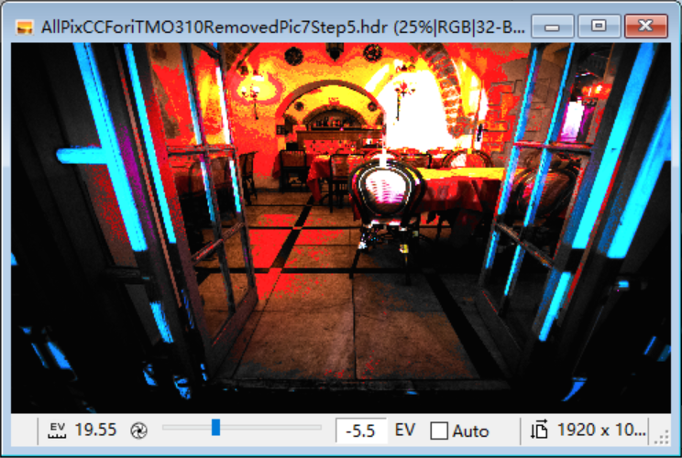
Existing problems
Bad result of colour corrected HDR images with alpha map step=5
Improvement to the bad result
Notes:
iTMO is realized through Expansion Operators (EO), and the general global tone expansion models are based on the luminance part of an image. Since we can’t extract the luminance component directly from the RGB color space, we need to convert the RGB image into another color space to do the tone expansion process.In our project, we will convert the RGB color space into XYZ YCbCr LMS ICtCp 4 different color spaces to see the results. Each conversion has its own method settled by CIE and is presented as follows.

Slide 32
Akyuz
iTMO
3.png named the Lake

Slide 33
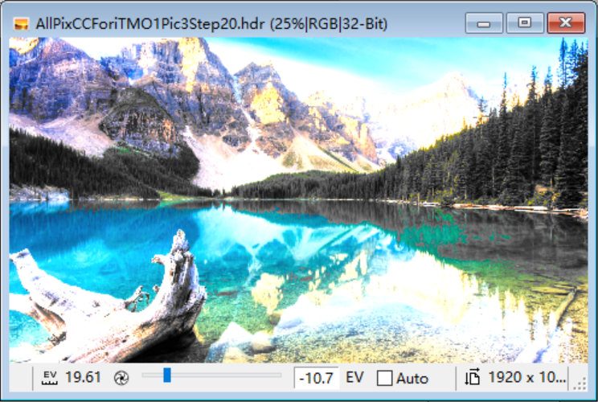
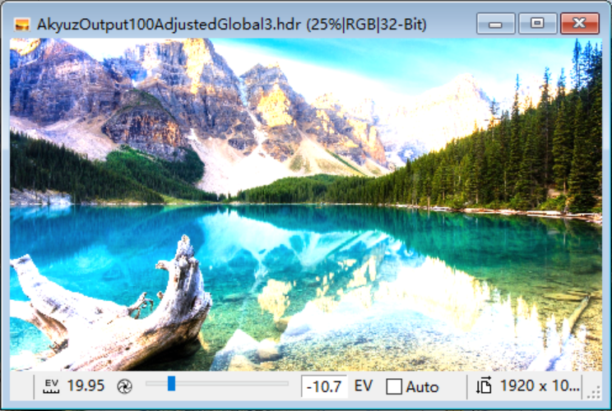


Color correction result
Color corrected HDR image of Akyuz iTMO with step 20.
Color corrected HDR image of Akyuz iTMO with global alpha 1
Output HDR image of Akyuz iTMO.
Color corrected HDR image of Akyuz iTMO with step 5.
Notes:
iTMO is realized through Expansion Operators (EO), and the general global tone expansion models are based on the luminance part of an image. Since we can’t extract the luminance component directly from the RGB color space, we need to convert the RGB image into another color space to do the tone expansion process.In our project, we will convert the RGB color space into XYZ YCbCr LMS ICtCp 4 different color spaces to see the results. Each conversion has its own method settled by CIE and is presented as follows.

Slide 34
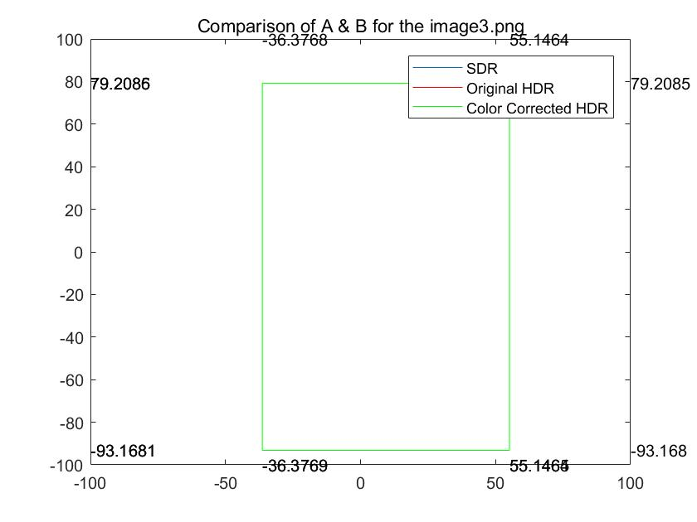
Improvement - range of a and b

Slide 35
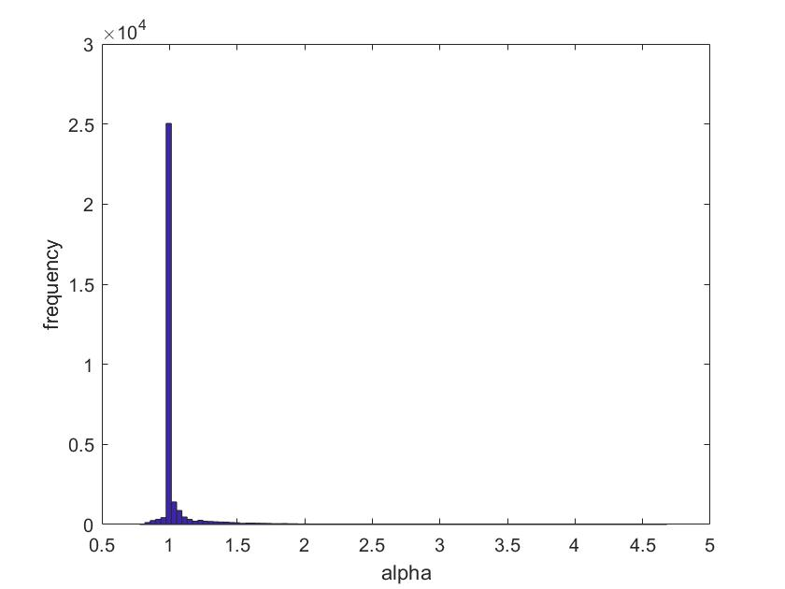
Histogram

Slide 36
deltaE
Test Frames | HDR | Global Alpha | HDR CC step=20 | HDR CC step=5
1- Chair | 262.46 | 262.46 | 3832.68 | 276.83
2 - Car | 226.93 | 226.93 | 3429.72 | 216.83
3 - Lake | 201.47 | 201.47 | 36060.55 | 164.52
4 - Family | 205.08 | 205.08 | 3573.66 | 90.56
5 - Garden | 179.06 | 179.06 | 1377.43 | 239.66
6 - Home | 225.85 | 225.85 | 1836.01 | 117.11
7 - Restaurant | 262.46 | 487.04 | 4278.46 | 537.52

Slide 37
Conclusion

Slide 38
Conclusion
The global colour correction adjustment applies a global alpha value to all the pixels of the HDR image to minimize the deltaE value between the adjustment result and the original SDR image. The global alpha values are image-specific.
The local colour correction adjustment applies local alpha values to individual pixels of the HDR image to minimize the deltaE value between the adjustment result and the original SDR image. An alpha map is used to contain all the local alpha values for each LAB value. The alpha maps are iTMO-specific.
The subjective colour correction results are presented in this report. The color corrected images with global alpha appears with colour closer to the original SDR image. For Bist iTMO HDR images, colour correction with local alpha values results in further improvements in colour resemblance. In terms of objective results, deltaE values suggest colour correction improvements on Bist iTMO resulting HDR images.
The local colour correction adjustment has its limitations. Because it only considers individual pixel values without considering the neighbour pixels. It cannot be readily applied on certain iTMOs including Banterle and Meylan that consider neighbour pixels for the iTMO process. More future effort is needed to generalize the application of the local method on all iTMO results.

Slide 39
Thank You!
We would like to express our special thanks and gratitude to
Dr. Mahsa Pourazad,
Pedram Mohammadi,
Dr. Panos Nasiopoulos,
Maryam Azimi, and
Stelios Ploumis
for providing us with guidance and help on the project.

Slide 40
Q&A

